Slide 1
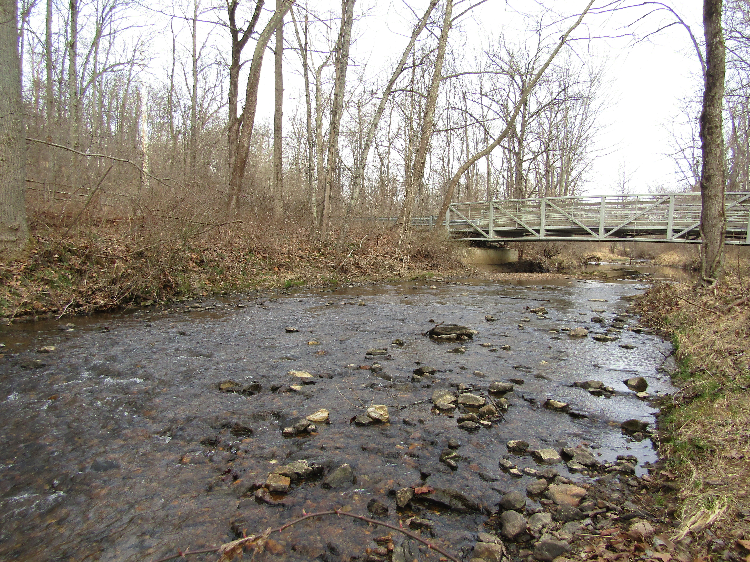
A Comparison of Benthic Communities and Water Quality in Red Run Watershed Over Two Decades of Urban Development
Nguyen Tien Anh Quach and Susan Gresens
Department of Biological Sciences
Towson University

Slide 2
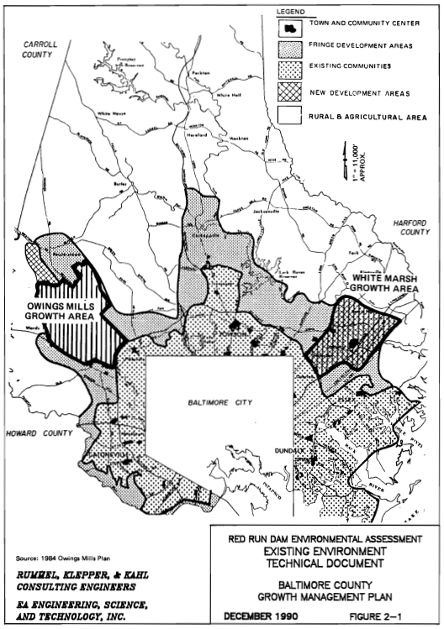
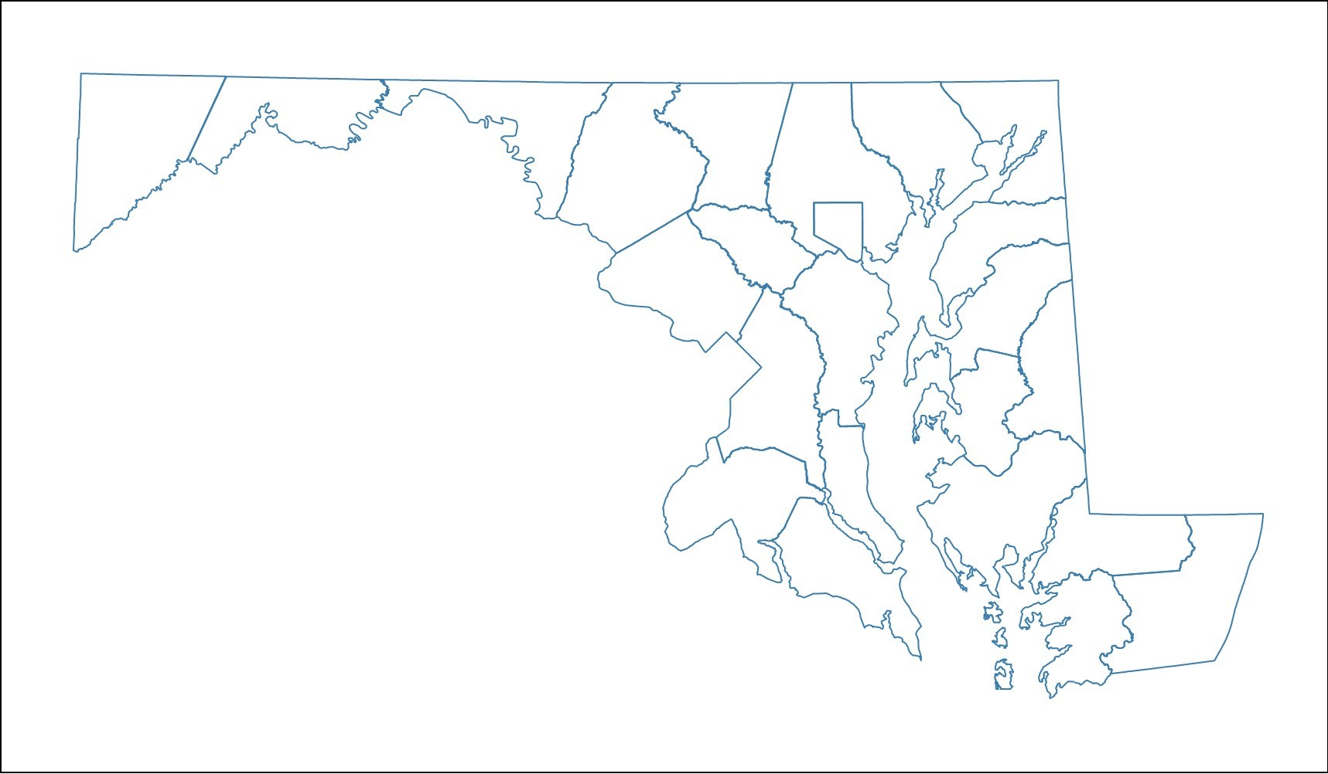
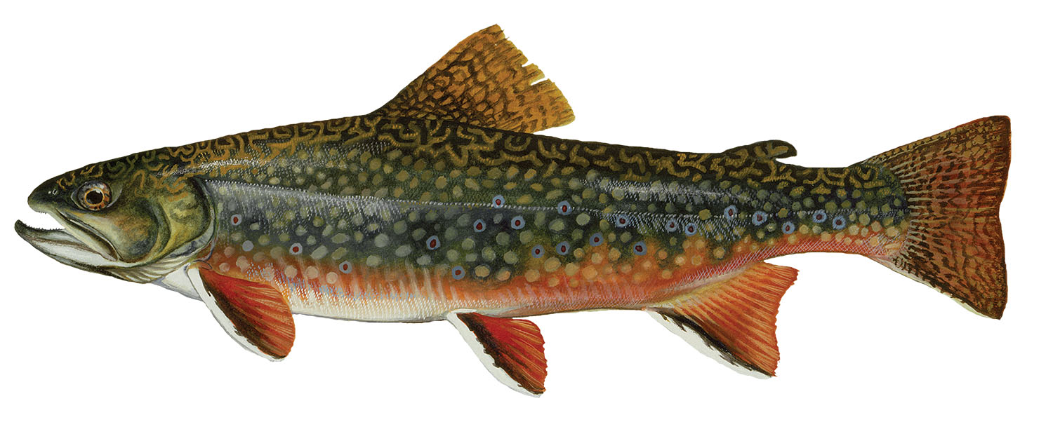
Baltimore County, MD
1979: County Council adopted a 20-year plan
Owings Mills Town Center
Red Run Dam
1990: Technical Report
Vol 1/2/3
Maryland
Notes:
Tell a story!
Red Run dam
Owings Mills cluster development: https://www.baltimorecountymd.gov/departments/economicdev/meet-baltimore-county/business-communities/owingsmills.html
The county was trying to manage growth by creating two town centers, including Owings Mills
Construct a regional flood control/stormwater management facility in RR watershed, where growth will occur
=> Basis for 1990 bioassessment

Slide 3
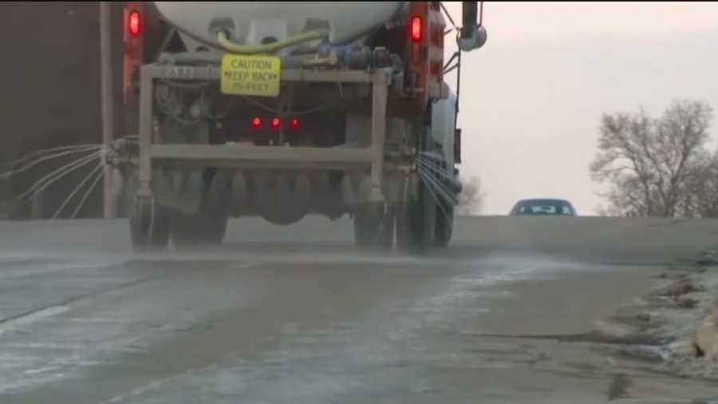
Salt Application in Baltimore County, MD
From 2001 to 2021
More than 8 million dollars
Nearly 61,000 tons of salt *
Stormwater BMPs
Zooplankton ¹
Amphibians ²
Streams
Fish ³
Benthic macroinvertebrates ⁴
Image from https://www.wbaltv.com/article/salt-brine-used-to-treat-roads-can-damage-your-car/7092181
* https://www.baltimorecountymd.gov/departments/publicworks/highways/stormrelatedcosts.html

Slide 4
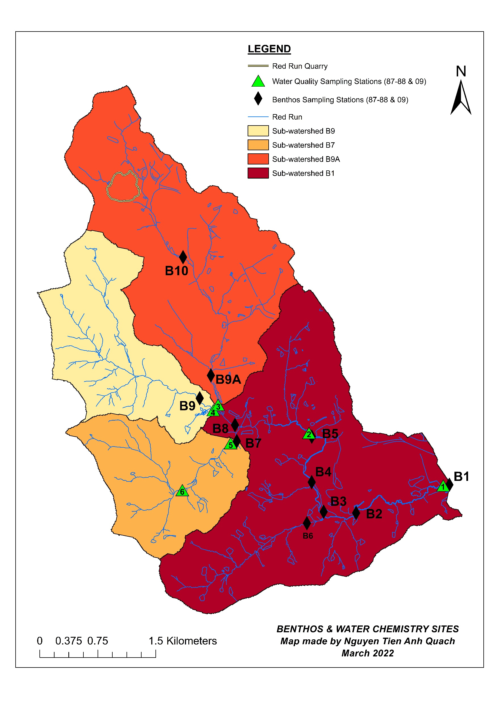
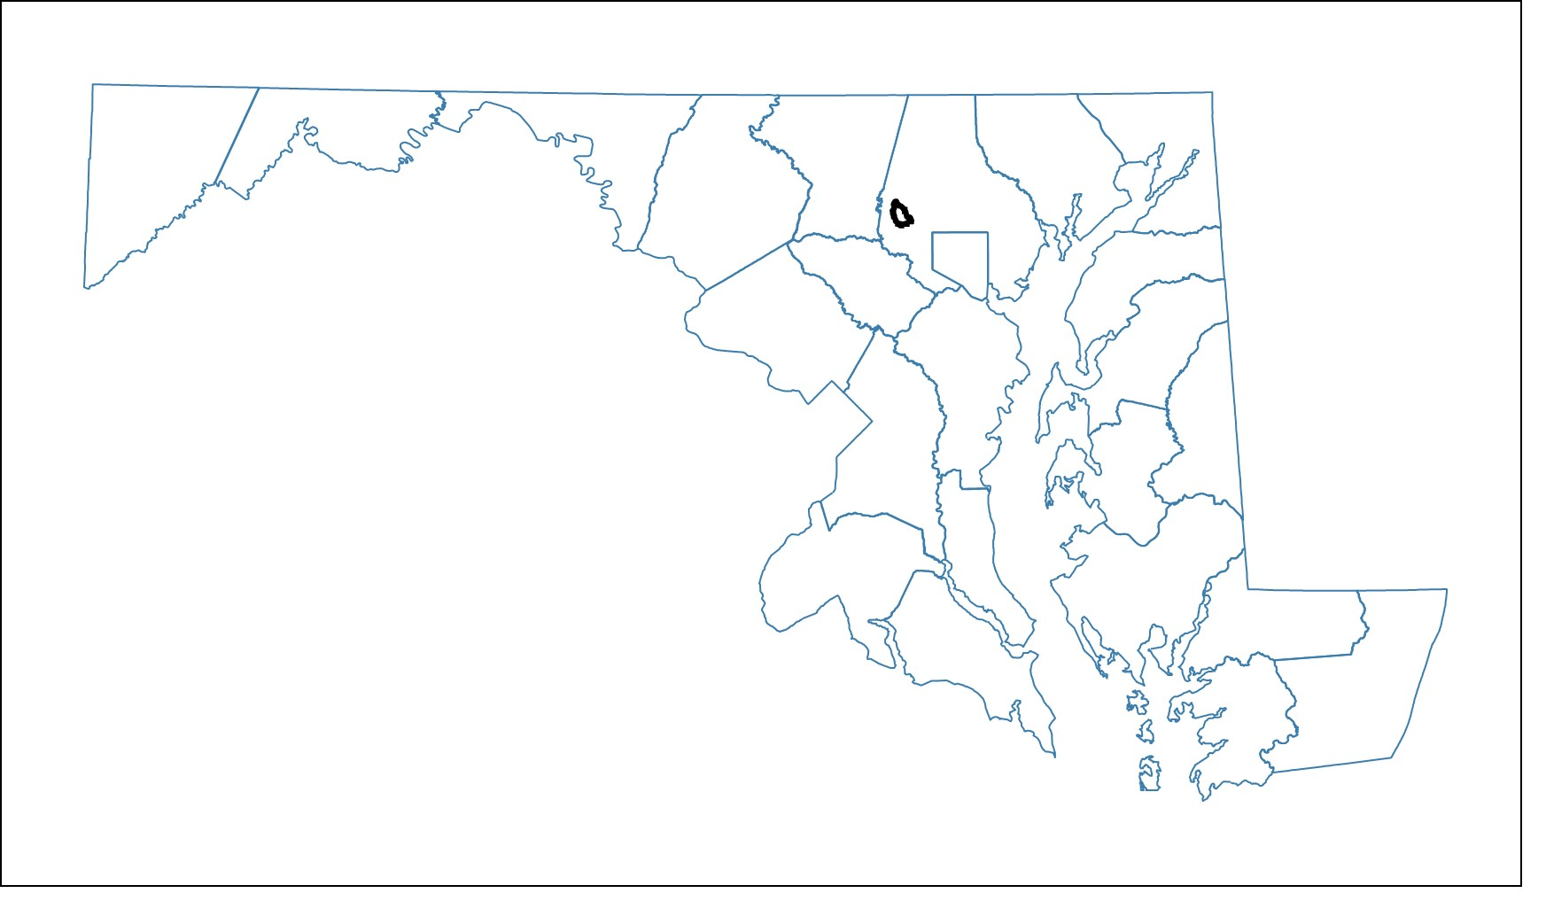
Maryland
Sub-watershed | Number of benthic sampling stations | Number of water quality sampling stations
B9 | 1 | 1
B7 | 1 | 2
B9A | 2 | 1
B1 | 6 | 2
Notes:
Image of MD and RR showing benthic and water quality sampling sites
1990 Report finding about brook trout.
2009 Repeated Sampling: Hess
Water quality sampling: Same stations.
=> Importance of the study: Before and After; paired design

Slide 5
Research Questions
How did (a) land cover and (b) water chemistry change over the period 1987-2009?
How did benthic macroinvertebrate communities respond to rapid urban development?
Was there evidence of which stressor(s) caused benthic decline? (a) a combination of multiple urban stressors or (b) salinity?

Slide 6
Research Questions
How did (a) land cover and (b) water chemistry change over the period 1987-2009?
How did benthic macroinvertebrate communities respond to rapid urban development?
Was there evidence of which stressor(s) caused benthic decline? (a) a combination of multiple urban stressors or (b) salinity?

Slide 7
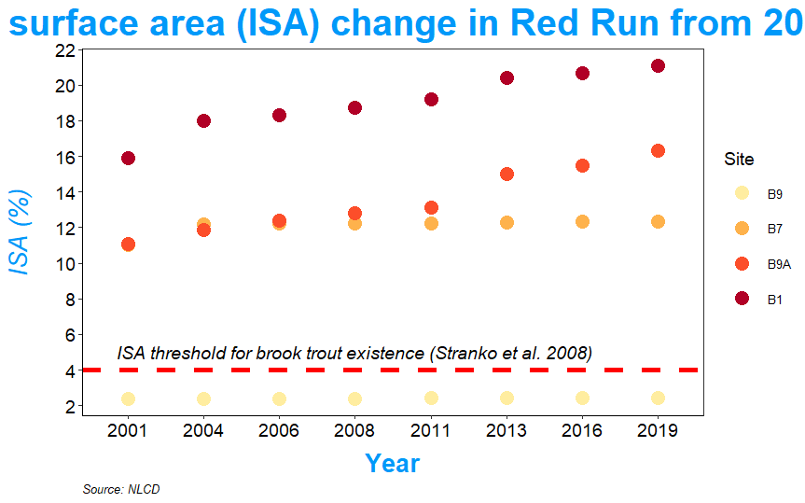
1a. Increase in % ISA varied greatly among the four sub-watersheds
Percentage of impervious surface area (ISA)
in Red Run from 2001 to 2019

Slide 8
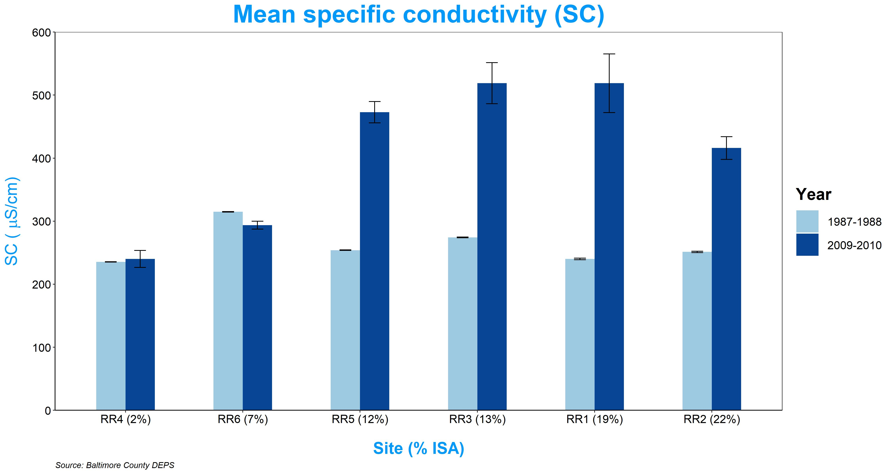
1b. Increases in SC and conc. of Cl⁻ and Ca²⁺ in sub-watersheds with high % ISA.
No change in pH, water temperature, and DO
Significant correlations between:
Cl⁻ and Ca²⁺ (R² = 0.93; p < 0.001)
Cl⁻ and SC (R² = 0.91; p < 0.001)
Ca²⁺ and SC (R² = 0.83; p < 0.001)
N₁₉₈₇ = 11
N₂₀₀₉ = 10

Slide 9
Research Questions
How did (a) land cover and (b) water chemistry change over the period 1987-2009?
How did benthic macroinvertebrate communities respond to rapid urban development?
Was there evidence of which stressor(s) caused benthic decline? (a) a combination of multiple urban stressors or (b) salinity?

Slide 10
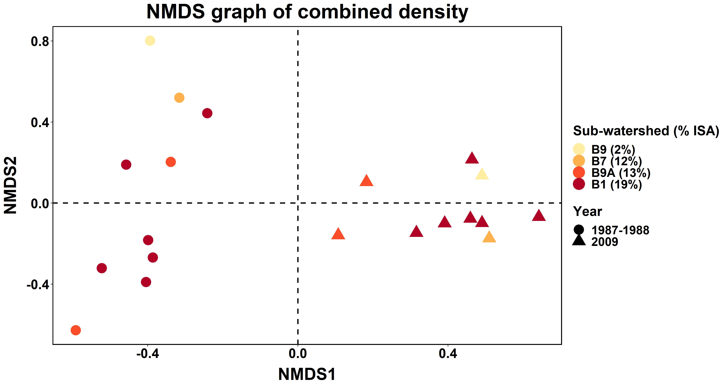

Slide 11
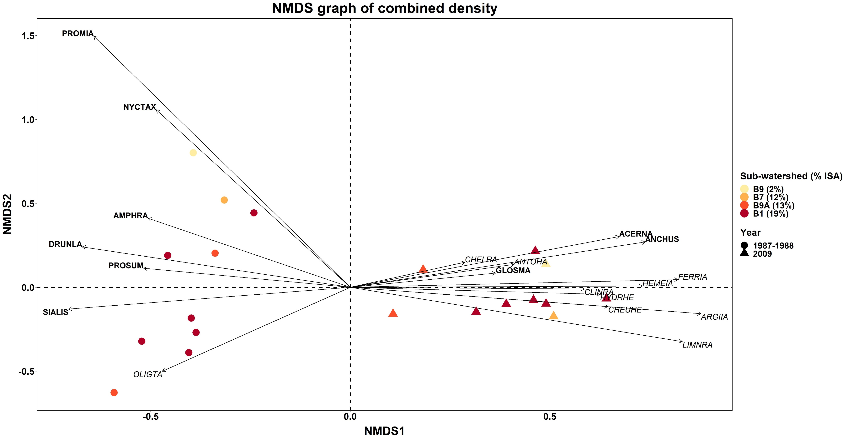
Sensitive taxa: bold
Tolerant taxa: italic
Cl⁻ (p = 0.015) and SC (p = 0.021)
Ca²⁺ (p = 0.055)

Slide 12
Research Questions
How did (a) land cover and (b) water chemistry change over the period 1987-2009?
How did benthic macroinvertebrate communities respond to rapid urban development?
Was there evidence of which stressor(s) caused benthic decline? (a) a combination of multiple urban stressors or (b) salinity?

Slide 13
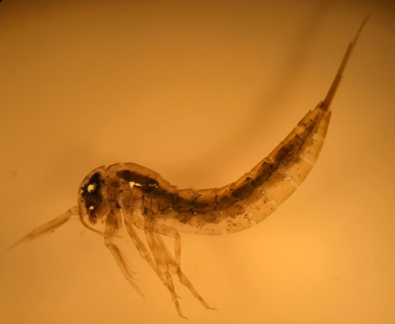
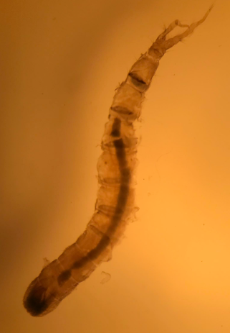

3a. Urban stressors: Are mean tolerance values of “disappeared” taxa significantly lower than those of randomly lost taxa?
Tolerance Value ⁵
* Sensitive taxa are intolerant to pollution and have tolerance values $≤$ 3 (out of 10)
Isonychia (Ephemeroptera)
Antocha (Tipulidae)
Notes:
Hypotheses:
Null hypothesis: Taxa were lost totally due to random chance.
A priori/alternative hypothesis: Based on changes in land cover and water chemistry, urban intolerant taxa were lost.
Tool used: Randomization test
Test statistic: Mean tolerance value of lost taxa
Results: At B1, B2, and B7, null hypothesis rejected.

Slide 14
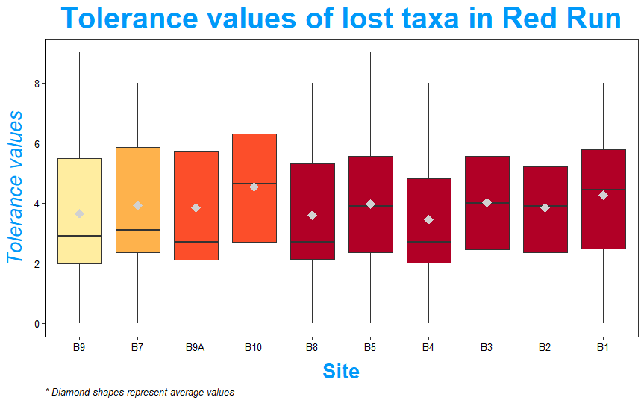
*
*
*
3a. There were evidences of urban stressors on “disappeared” taxa

Slide 15
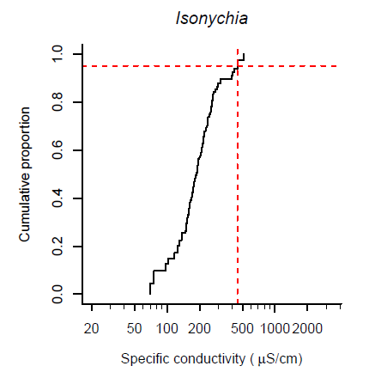
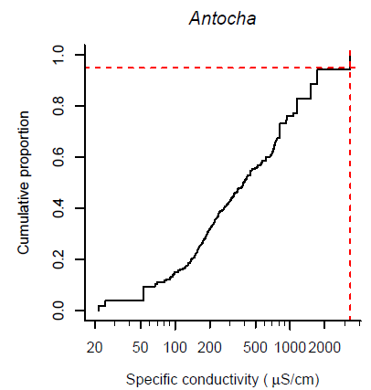
3b. Salinity stressors: Are mean XC₉₅ of “disappeared” taxa significantly lower than those of randomly lost taxa?
XC₉₅ ⁶
Notes:
DIFF = 1987-2009
Only Spring data were used to compared since the protocol is to sample in the Spring.

Slide 16
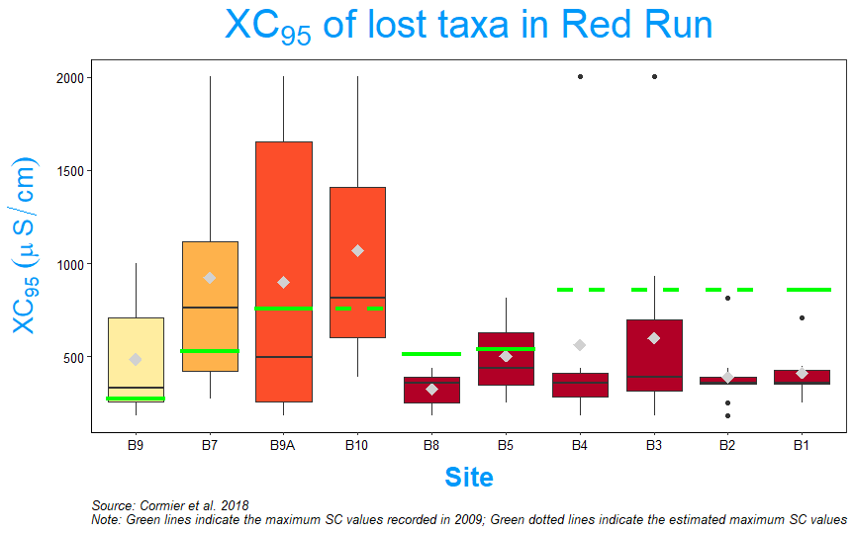
*
*
*
3b. There were evidences of a salinity stressor on “disappeared” taxa
Notes:
DIFF = 1987-2009
Only Spring data were used to compared since the protocol is to sample in the Spring.

Slide 17
Conclusion
Increases in ISA and SC (also Cl⁻ and Ca²⁺) with great variations among sub-watersheds.
Benthic assemblages were completely dissimilar between 1987 and 2009.
De-icing salt was likely a driving cause of benthic declines.

Slide 18
References
van Meter, R. J., Swan, C. M., & Snodgrass, J. W. (2011). Salinization alters ecosystem structure in urban stormwater detention ponds. Urban Ecosystems, 14(4), 723–736. https://doi.org/10.1007/s11252-011-0180-9
Morgan, R. P., Kline, K. M., Kline, M. J., Cushman, S. F., Sell, M. T., Weitzell, R. E., & Churchill, J. B. (2012). Stream Conductivity: Relationships to Land Use, Chloride, and Fishes in Maryland Streams. North American Journal of Fisheries Management, 32(5), 941–952. https://doi.org/10.1080/02755947.2012.703159
Gallagher, M. T., Snodgrass, J. W., Brand, A. B., Casey, R. E., Lev, S. M., & van Meter, R. J. (2014). The role of pollutant accumulation in determining the use of stormwater ponds by amphibians. Wetlands Ecology and Management, 22(5), 551–564. https://doi.org/10.1007/s11273-014-9351-9
Tyree, M., Clay, N., Polaskey, S., & Entrekin, S. (2016). Salt in our streams: even small sodium additions can have negative effects on detritivores. Hydrobiologia, 775(1), 109–122. https://doi.org/10.1007/s10750-016-2718-6
Southerland, M. T., Rogers, G. M., Kline, M. J., Morgan, R. P., Boward, D. M., Kazyak, P. F., Klauda, R. J., & Stranko, S. A. (2005). New biological indicators to better assess the condition of Maryland streams. Publication # DNR-12-0305-0100. Maryland Department of Natural Resources Monitoring and Non-Tidal Assessment Division, Annapolis, MD
Cormier, S. M., Zheng, L., & Flaherty, C. M. (2018). A field-based model of the relationship between extirpation of salt-intolerant benthic invertebrates and background conductivity. Science of The Total Environment, 633, 1629–1636. https://doi.org/10.1016/j.scitotenv.2018.02.044

